Slide 1
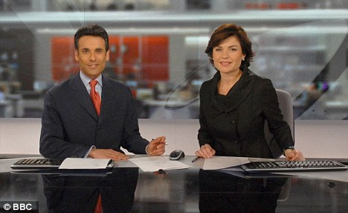
Writing to Inform

Slide 2
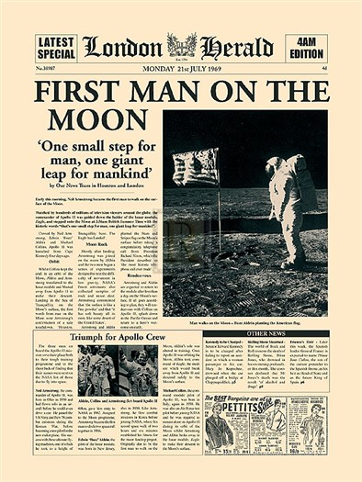
Informative Texts
Informative texts
give you information about something.
To inform means to give facts to another person.
Newspapers

Slide 4
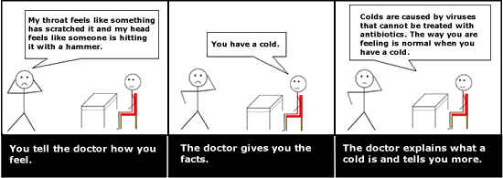
You feel ill and go to see a doctor. Which of the
following is informing, explaining or describing?
Describing - telling the doctor how you feel.
Informing - the doctor gives you the facts.
Explaining - the doctor explains what a cold is and tells you more about it.

Slide 5
1)Make sure
language is clear, factual and impersonal.
2)Break up the
writing with diagrams and subheadings.

Slide 6
When reading a information text you should remember the 5 W’s
Who is it from/to/about?
What is it about?
Where is it about?
When was it written/did the event take place?
Why is it being written?
How are you meant to react?

Slide 7
G | P | H | P | D | N | W | D | I | L
M | F | W | L | L | H | W | Z | H | F
A | Y | H | J | E | J | G | E | O | I
D | Y | K | N | P | C | L | E | A | R
A | B | O | S | N | Q | G | N | M | H
A | H | R | T | G | G | E | J | O | J
B | O | Y | G | E | R | E | H | W | Q
S | W | C | N | Z | R | V | F | U | W
T | M | P | D | S | S | E | Y | S | O
A | R | M | O | B | P | E | T | C | H
H | T | F | O | G | H | C | K | O | U
W | M | J | T | R | A | P | L | R | W
C | X | O | L | F | S | W | F | M | I
Facts
Clear
Who
What
Where
When
How

Slide 8
As a class decide on the 5 W’s in this news report.

Slide 9
Task
Make notes using informative writing on the video clip you are about to see.
You must use the 5 W’s!

Slide 10
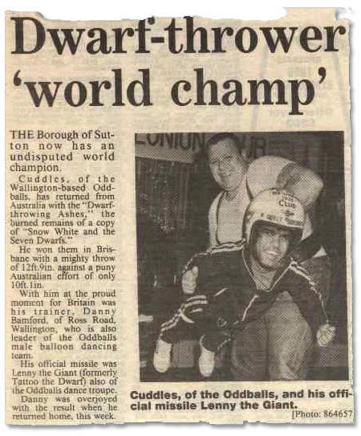
Task
In pairs/groups, you have 5 minutes to cut out an image from the newspaper.
Pick an image that is:
Interesting
Strange
Funny

Slide 11
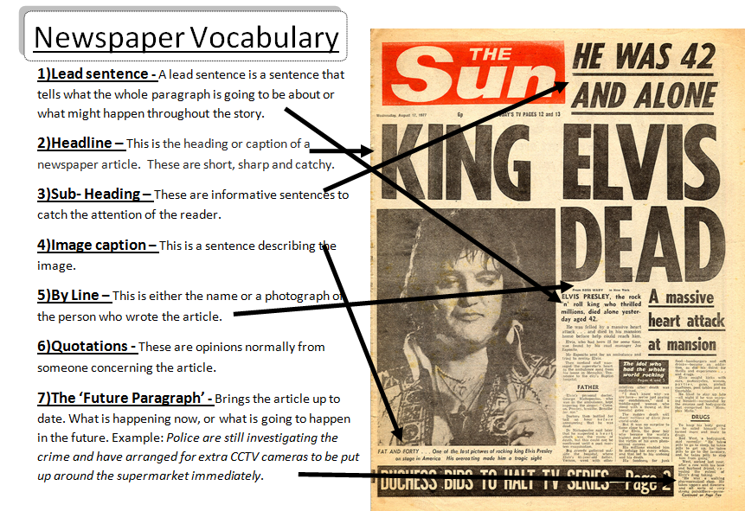

Slide 12
30 points total:
All components –
1 point each (10)
Future Paragraph – 10 points (grammar, structure, 5 Ws + H)
Presentation – 10 points (Eye contact, clear, composed, all group members share)
Due at the end of class September 25th (P4) / September 26th (p5)
And

