Slide 1
Writing to Inform
Mrs. Darrell

Slide 2
To inform means to give facts to another person.
If you were informing someone about a job, you should:
Use straightforward language to convey essential information.
For example, what is involved in the job?
Give the readers a bit more information.
For example, what is interesting about the job and what you enjoy about it?
Remember you are giving information.
Imagine that someone asked about your job because they are thinking they might like a similar one.

Slide 3
GAPS
Think about genre, audience, purpose and style.
Genre - could be giving instructions, recipes, directions, manuals, science experiment
Audience - could be anyone
Purpose - to inform - giving unbiased information which is reliable and factual
Style - formal

Slide 4
Useful Techniques
When writing to inform, make sure language is :
clear, factual and impersonal.
Use short and clear sentences.
Break up the writing with diagrams, illustrations, pictures and subheadings.

Slide 5
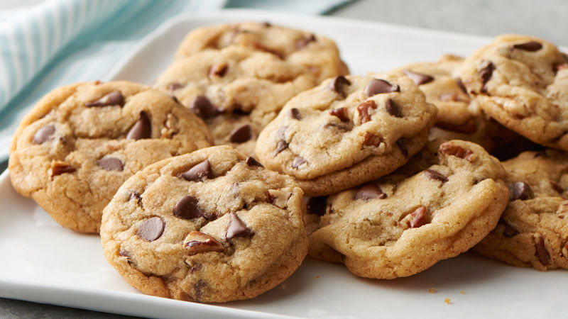
Chocolate chip cookies recipe
Heat the oven to 200°C/Gas 6. Line two baking sheets with baking parchment. Chop the chocolate into chunks and put to one side.
Heat the butter in a small saucepan gently until it has melted. Meanwhile, put the two types of sugar into a mixing bowl. Pour the melted butter on top of the sugar and beat well with a wooden spoon.
Add the egg and the vanilla and beat until well blended.
Sift the flour, baking powder and salt into the mixing bowl and stir them in, then add the chopped chocolate.
Dot heaped pudding spoonfuls of the mixture over the lined baking sheets.
Wearing oven gloves, put the baking sheets in the oven and bake for 8-10 minutes, until the cookies are just turning golden brown.
Leave them to harden for a couple of minutes before eating.

Slide 6
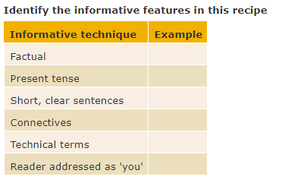

Slide 7
Homework
Choose a recipe
Write at least 6 steps to create this dish
Be prepared to share on Thursday / Friday!

