Slide 1
Notecards

Slide 2
What is a research note card?
Notecards are 3x5 index cards with only one, just one, no more than one fact per card.
There are 4 components to making an MLA notecard. Example on next slide.

Slide 3
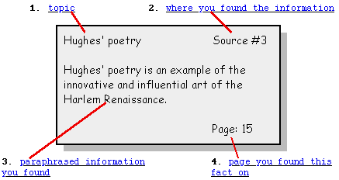
4 Items to include on card
.

Slide 4
So, what goes on the Note Card??
As you find interesting facts about your topic, you will write them down.
Each idea should be paraphrased/summarized (in your own words) or quoted and written on a card.

Slide 5
How do you record information on the notecard?
Paraphrase/Summarize—shorter, in your own words; rewrite what the author said
Quote—stating exactly what the author said; must use quotation marks
DON’T PLAGIARIZE!!!! ALWAYS GIVE THE CREDIT TO THE REAL AUTHOR!

Slide 6
PLAGIARISM
It's like lip-synching to someone else's voice and accepting the applause and rewards for yourself.
IF YOU PLAGIARIZE, YOU WILL FAIL!!! …any time you take a writer’s words and use them as your own, you are plagiarizing

Slide 7
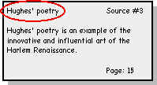
1. Card Topic
Topic is the kind of information on the card.
Think of it as the title, or main idea of the card. After writing down the information, figure out how you could briefly categorize, or title it.

Slide 8
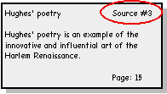
2. Source Title
The source title is the name of the book, magazine, website, etc., in which you found the information.

Slide 9
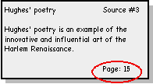
4. page numbers
It is important to be accurate with the page numbers on your note cards, as you will need them for citations throughout your research paper.

Slide 10
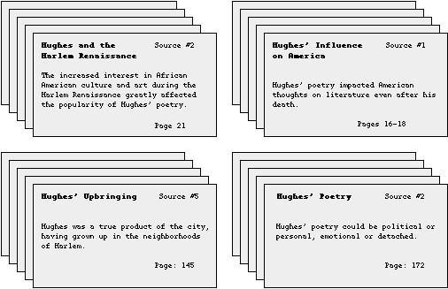
Sample Note Cards
Organized by Card Topic

Slide 11
Citing my source!!
Information for this presentation came from the following source
“Researching and Organizing Your Paper: The Note Card System.” English Works! at Gallaudet University, Washington, D.C. Published: 1997-present. Retrieved 7 March, 2006. <http://depts.gallaudet.edu/englishworks/writing/notecard.html>

